Slide 1

COVID BED OCCUpancy PRediction
Rishabh Padore

Slide 2
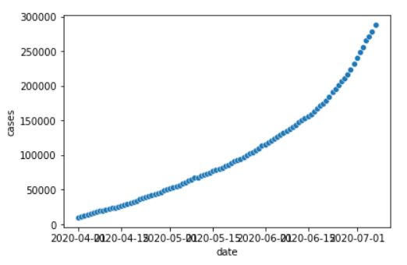
The Problem
COVID 19 cases in the last couple months grew
65% every week
Hospitals were flooded and there was no room for patients
Need to predict how many rooms were needed based on how the cases increase
Can we predict how many hospital beds are needed?
What factors affect the hospital bed occupancy?

Slide 3



Who might care?
CDC
Hospital Board Members
General Population

Slide 4
What factors affect Hospital Bed Occupancy
COVID Cases/Deaths
State
Date
Hospital Bed Occupancy
ICU Bed Occupancy
Case Count Data from CDC
CDC Hospital Occupancy Dashboard

Slide 5
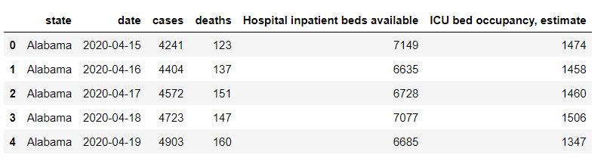
Data Information
Data is merged under the state and date key
Data structure is shown below

Slide 6
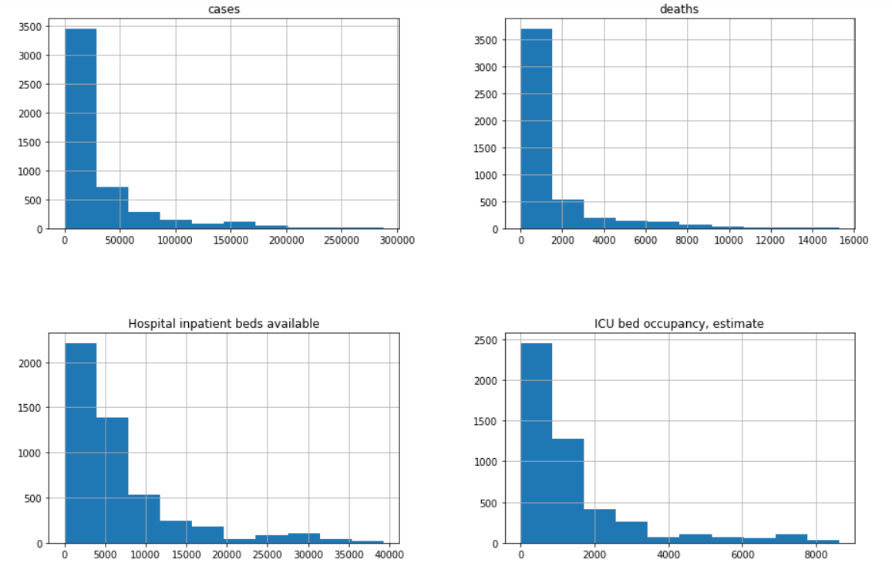
Data Exploration
Distribution spread
Skewed
Needs scaling

Slide 7
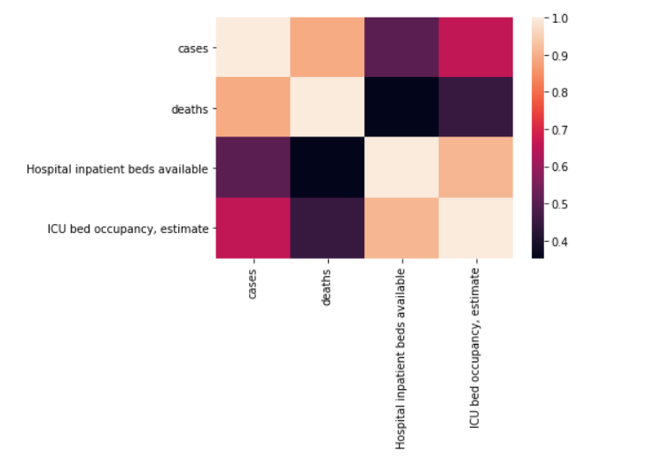
Data Heatmap
High correlation between cases and deaths
As well as inpatient beds and ICU occupancy

Slide 8
Machine Learning Module
Type: Supervised Learning
Regression classification: the bed occupancy can range
Skewed data so needs to be scaled
Tools: sklearn
Pre-processing steps: Label encoding, scaling, test train split, modeling

Slide 9
Algorithms used
Ordinary Least Squares Regression – simple linear regression with best fitted line
Random Forest Regressor- performed best and was very accurate in predictions
Ridge Regression – deals well with highly correlated variables

Slide 10
Scoring Breakdown
Ridge Regression
Random Forest Regressor
OLS
R squared: 0.9794276376093384
MSE: 0.14770625972825185
R squared: 0.9917584207418481
MSE: 0.01235097215788602
R squared: 0.979
MSE: 0.1475761580585963

Slide 11
Assumptions, Limitations, Disclaimers
There is a high amount of collinearity between the different metrics in the data
We only used a couple months of data
The model needs more data inputted and more variables to achieve a more colorful view on the occupancy
We could pull in more mask data in order to push agendas and prevent overflowing
Pull in more hospital data such as workers to ensure that patients are being provided for

Slide 12
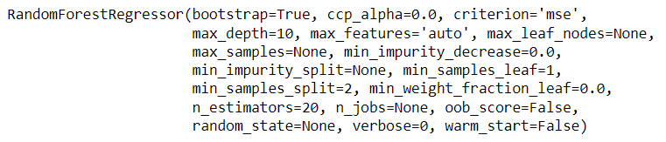
Conclusion
Overall able to achieve a high performance model on a low amount of data
All of the features were being used and all contributed to the predictive power of the model
The random forest regressor was the best model for this data
The features of the model can be seen below

